Slide 1
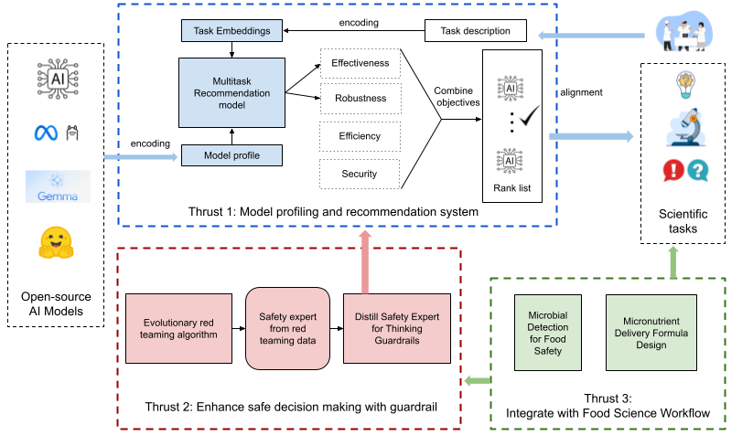
FoodGuard: Enabling a Safe and Directive Multi-modal Foundation Model Ecosystem for Food Science Research
PI:Zhe Zhao (UC Davis) Co-PIs: Muhao Chen (UC Davis) Xin Liu (UC Davis), Nitin Nitin (UC Davis)
Collaboration and Usability Challenge Addressed
AI Model Profiling and recommendation for scientific tasks.
Guardrail for model safe usage in scientific collaboration.
Integrate with critical food science applications.
Technical Cybersecurity Solution
multi-task recommendation for AI model adaptation.
Evolutionary redteaming and slow thinking guardrail.
Practical and safe use of AI for food science workflow.
Benefits to Scientific Cyberinfrastructure
Scientists can reliably use AI models for their tasks.
Scale up use of AI with safety, security and robustness constraints.
Food science researchers advance their critical research applications.
Risks Versus Potential For Advances
Uncontrollably development of open source AI models for scientific advancement without robustness and safety check.
This project will enable safety scaling of AI tools for scientific research.
Result Dissemination Plans
A recommendation system that can provide AI model recommendation to food science researchers for their tasks.
AI model ecosystem with model profiles evaluated on effectiveness, safety, robustness and efficiency for scientific collaboration.
Research publications on the system, as well as datasets generated from the project.
Food science research advancement with the help of the developed system.
Programmatic Details
3 year project started on Sep 2025.
Led by UC Davis.
This material is based upon work supported by the National Science Foundation under Grant No. 2531126

